Slide 1
Point-to-Point
Access:
PPP
Acadimic Purpose Only (KIET CN SKK IT VI)

Slide 2
Point-To-Point Protocol
Frame Format
Transition States
Acadimic Purpose Only (KIET CN SKK IT VI)

Slide 3
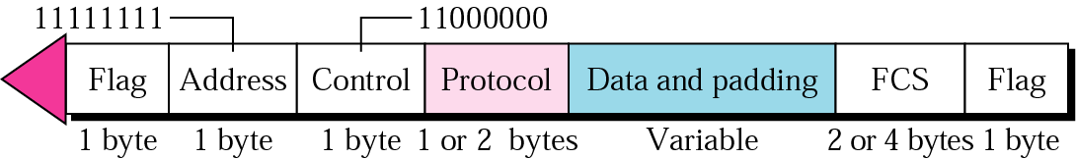
PPP frame
Acadimic Purpose Only (KIET CN SKK IT VI)

Slide 4
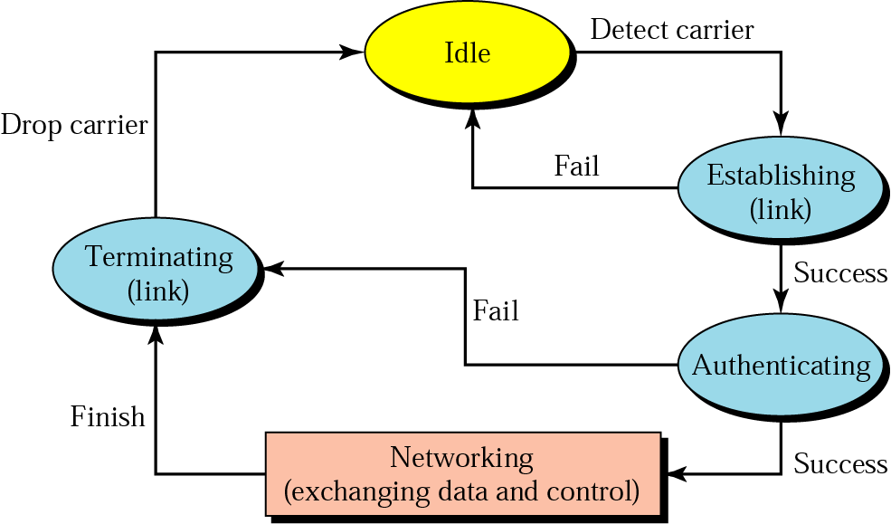
Transition states
Acadimic Purpose Only (KIET CN SKK IT VI)

Slide 5
PPP Stack
In order to establish the link, PPP uses
Stack of other protocols
Link Control Protocol (LCP)
Authentication Protocols
Network Control Protocol (NCP)
Acadimic Purpose Only (KIET CN SKK IT VI)

Slide 6
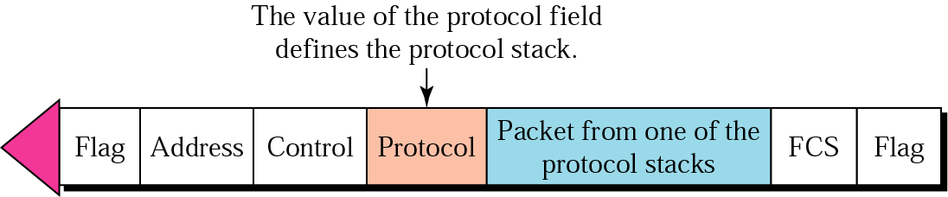
Protocol stack
Acadimic Purpose Only (KIET CN SKK IT VI)

Slide 7
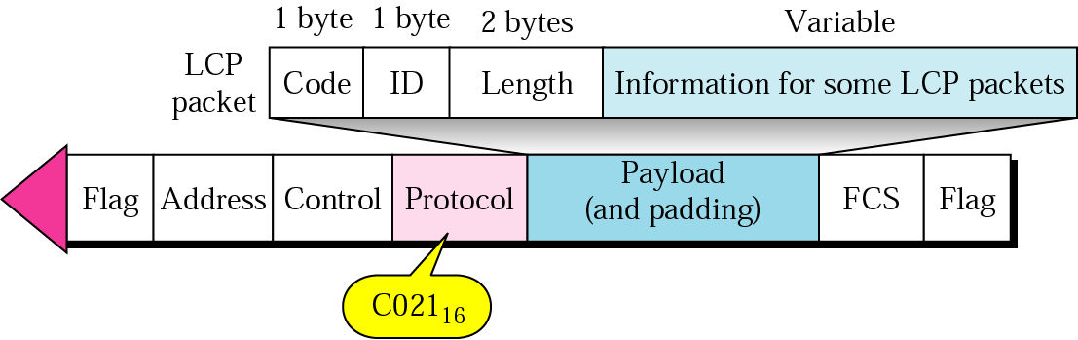
LCP packet encapsulated in a frame
Acadimic Purpose Only (KIET CN SKK IT VI)

Slide 8
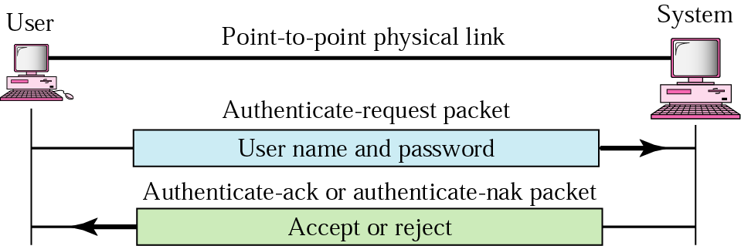
PAP
Acadimic Purpose Only (KIET CN SKK IT VI)

Slide 9
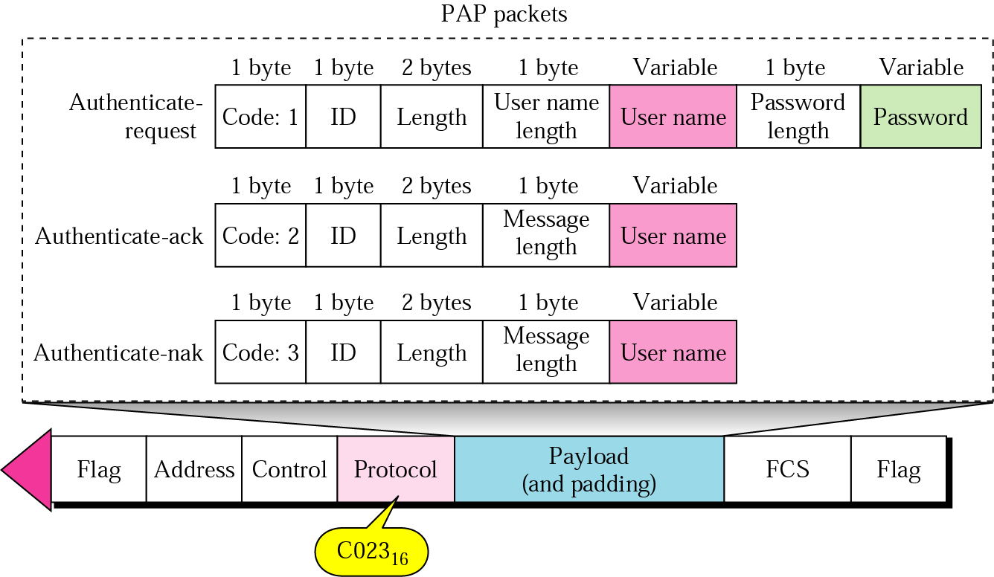
PAP packets
Acadimic Purpose Only (KIET CN SKK IT VI)

Slide 10
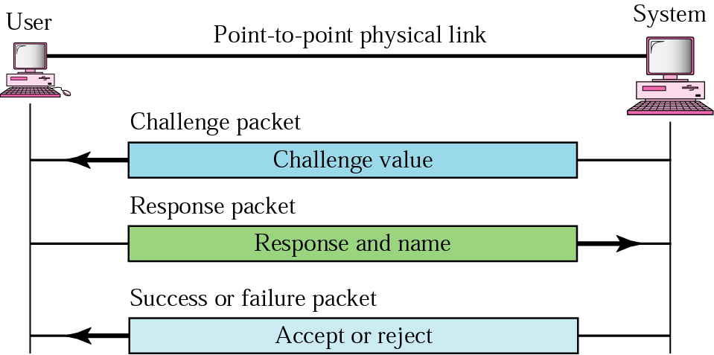
CHAP
Acadimic Purpose Only (KIET CN SKK IT VI)

Slide 11
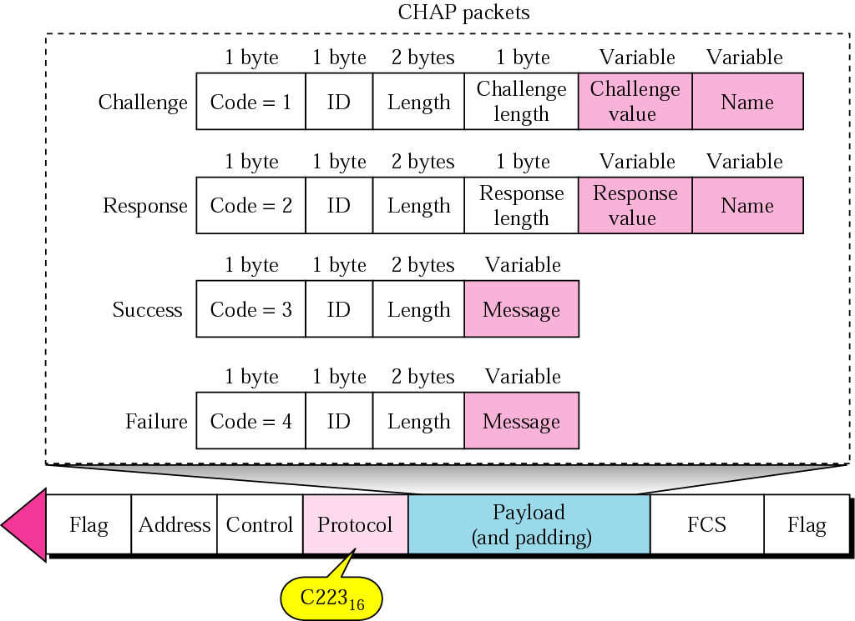
CHAP packets
Acadimic Purpose Only (KIET CN SKK IT VI)

Slide 12
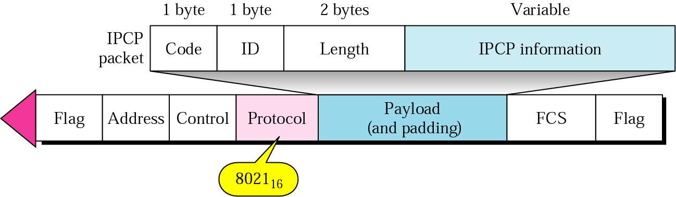
IPCP packet encapsulated in PPP frame
Acadimic Purpose Only (KIET CN SKK IT VI)

